Slide 1
Intelligent System
Local Search
Nunung Nurul Qomariyah
nunung.qomariyah@binus.edu

Slide 2
Session Learning Outcomes
Upon completion of this session, students are expected to be able to
LO 2 Understand different approaches and techniques in AI.
LO 3 Understand basic mathematical background used in AI.
LO 4 Apply appropriate computing and mathematical techniques in AI case.

Slide 3
Outline
Local Search:
Hill-climbing
Local (and Semi-Global) Search:
Simulated annealing
Genetic Algorithm

Slide 4
What kind of problem?
In week 2 we addressed a single category of problems:
Observable
Deterministic
Known environments
The solution is a sequence of actions.
Now, we look at what happens when these assumptions are relaxed.
S
h=8
A
h=8
B
h=4
C
h=3
G
h=0

Slide 5
Complete Searching
Partial searching:
seeks a goal node and constructs a path from the start to a goal state
BFS, DFS, UCS, Greedy, etc.
A* searches different solutions by looking at estimated cost of a solution path.
S
h=8
A
h=8
B
h=4
C
h=3
G
h=0

Slide 6
Complete Searching
Complete searching: every node is a solution
operators go from one solution to another
can stop any time and have a valid solution
search is now about finding a better solution.
No longer searching state space for a solution path.
f(x)=total distance
20
S-A-G
16
15
S-B-G
12
S-C-G
11
10

Slide 7
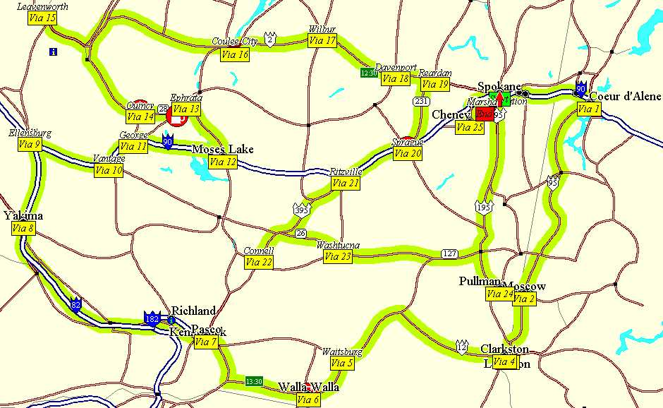
Travelling Salesman Problem (TSP)
Classic NP-Hard problem:
A salesman wants to visit a list of cities
stopping in each city only once
returning to the first city
travelling the shortest distance
A problem is NP-hard if an algorithm for solving it can be translated into one for solving any NP-problem (nondeterministic polynomial time) problem. NP-hard therefore means "at least as hard as any NP-problem," although it might, in fact, be harder.

Slide 8
TSP (2)
Nodes are cities
Edges are labelled with distances between cities
Adjacency matrix:
5-city TSP
not to scale
A
A
B
C
D
E
5
8
A
0
5
8
9
7
B
6
C
B
5
0
6
5
5
9
7
C
8
6
0
2
3
5
5
2
3
D
9
5
2
0
4
D
E
E
7
5
3
4
0
4

Slide 9
TSP (3)
A solution is a permutation of cities, called a tour,
e.g. A-B-C-D-E
Assumes tours return home
How many possible solutions exist?
(n-1)! / 2, where n is # of cities
n = 5 results in 12 tours
n = 10 results in 181440 tours
n = 20 results in ± 6•10¹⁶ tours.
5-city TSP
not to scale
A
5
8
B
6
C
9
7
5
5
2
3
D
E
4
Note: this is assuming the start city is fixed and paths are symmetric.
(n! if the start city can be any cities and paths are asymmetric.)

Slide 10
TSP (4)
An operator is needed to transform one solution to another:
TSP: two-swap (common)
take two cities and swap their location in the tour
e. g. A-B-C-D-E swap(A, D) yields D-B-C-A-E
TSP: two-interchange
reverse the path between two cities
e. g. A-B-C-D-E interchange(A, D) yields D-C-B-A-E

Slide 11
TSP (5)
A TSP (with a two-swap operator) can be visualized as a function optimization problem as follows.
f(x)=tour distance
A
5
4
25
a-c-b-d
25
a-b-c-d
23
B
C
6
9
20
a-b-d-c
19
6
3
D
15

Slide 12
Complete Searching (2)
Complete searching is suitable for problems that
do not care about the solution path
aimed at optimizing an objective function
require exponential time to find the optimal solution (NP-Hard problems)

Slide 13
Complete Searching (3)
Hard problems can be solved in a reasonable time (i.e. polynomial) by either:
Approximate model: find an exact solution to a simpler version of the problem
Approximate solution: find a non-optimal solution of the original hard problem.
We'll explore means to search through complete solution space for a solution that is near optimal.

Slide 14
Localized Searching
Local search considers only those solutions in the neighbourhood
Global search would consider all possible solutions
Those solutions that can be reached with one application of an operator in the current solution's neighborhood
The neighborhood should be much smaller than the size of the search space (otherwise the search degenerates)

Slide 15
Localized Searching (2)
An evaluation function f(n) is used to map each solution to a number corresponding to the quality of that solution.
TSP: Use the distance of the tour path. A better solution has a shorter tour path.
Minimize f(n):
called valley finding (gradient descent if continuous)
Maximize f(n):
called hill climbing (or gradient ascent if continuous)
For TSP which technique would you use?

Slide 16
Valley Finding –TSP Example
5
a-b-c
5
c-b-a
5
a-c-b
4
b-c-a
4
4
3
b-a-c
3
Current node: a-b-c
Operator: 2-swap of consecutive cities
Distances (symmetric): a-b = 2, b-c = 3, c-a = 1.
Note: this is for illustration only since the return distance to the start city is not counted.

Slide 17

Hill Climbing (1)
Guess$x∈X$
$N$ = neighbourhood
Repeat:
Let n = ${argmax}_{n∈N}$ f(n)
If $f(n) > f(x) : x=n$
Else: stop
f(x)
n
x
x_{start}

Slide 18
Hill Climbing (2)
Hill climbing (HC) exploits the neighbourhood
like Greedy search it chooses what looks best locally
But doesn't allow backtracking or jumping to an alternative path since there is no (OPEN) nodes list
HC is very space efficient
CLOSED nodes list, if used, could become large
HC is very fast and effective in practice

Slide 19
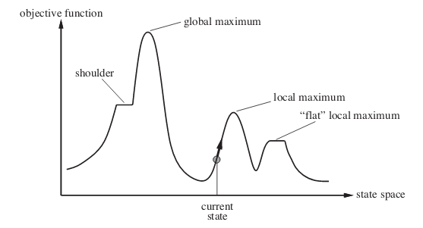
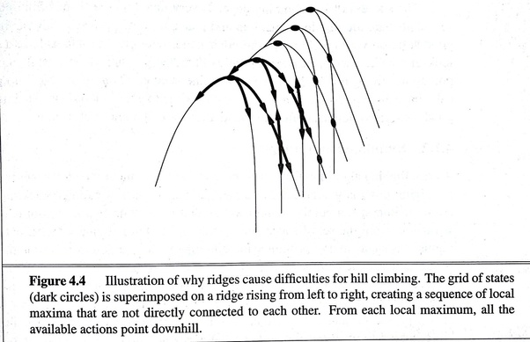
Local Optima
Solution found by Hill Climbing (or Gradient Descent) is totally determined by the starting point.
Fundamental weakness is getting stuck at:
Local maxima
Plateaus and Ridges
Global maxima may not be found.

Slide 20
Escaping Local Optima
HC gets stuck at local maxima limiting the quality of the solution found
Two ways to modify HC:
1. choice of neighbor
2. criteria for accepting neighbor for current
For example:
1. choose neighbor randomly
2. accept neighbor if it is better, or if it isn't, accept with some fixed probability p

Slide 21
Escaping Local Optima (2)
f(y)
y
Now we consider not only local neighbors.

Slide 22
Escaping Local Optima (3)
Modified HC with fixed probability p can escape from local maxima but
the chance of making a bad move is the same at the beginning of the search as at the end
the magnitude of improvement, or lack thereof, is ignored.
Fix by replacing fixed probability p with a temperature T that decreases as the search proceeds:
p = e ( eval(newNode) – eval(currentNode) ) / T
Now as the search progresses, the chances of taking a bad move reduces

Slide 23
Simulated Annealing
It picks a neighbor at random and either rejects or accepts the new assignment.
Annealing is a process in metallurgy where:
metals are slowly cooled to make them reach a state of low energy where they are very strong.
The random movement corresponds to high temperature;
at low temperature, there is little randomness.

Slide 24
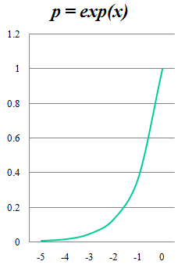
Simulated Annealing
Simulated annealing is a process where:
the temperature is reduced slowly
starting from a random search at high temperature eventually becoming pure greedy descent as it approaches zero temperature.
At high temperatures, worsening steps are more likely than at lower temperatures.

Slide 25
Simulated Annealing
To control how many worsening steps are accepted,
there is a positive real-valued temperature T.
Suppose A is the current assignment of a value to each variable.
Suppose that h(A) is the evaluation of assignment A to be minimized.
For solving constraints, h is typically the number of conflicts.
Simulated annealing selects a neighbor at random, which gives a new assignment A'.
If h(A') ≤ h(A), it accepts the assignment and A' becomes the new assignment.
Otherwise, the assignment is only accepted randomly with probability

Slide 26

Simulated Annealing
Thus, if h(A') is close to h(A), the assignment is more likely to be accepted.
If the temperature is high , the exponent will be close to zero and so the probability will be close to 1.
As the temperature approaches zero , the exponent approaches -∞, and the probability approaches zero.

Slide 27
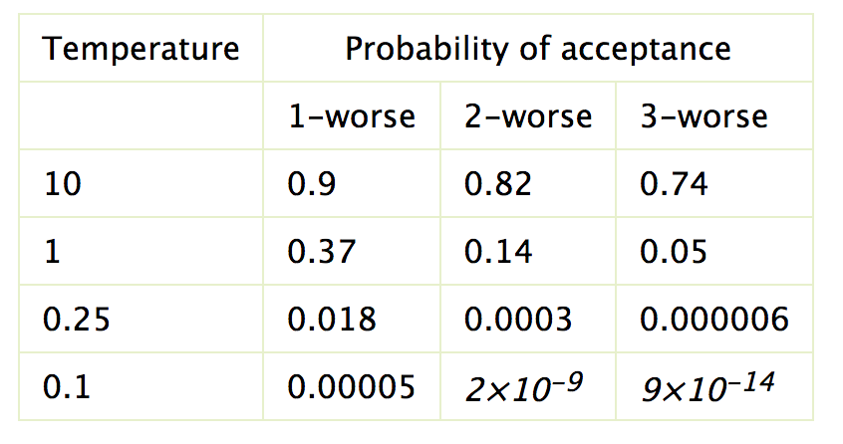
Simulated Annealing
h(a)-h(a')=-1
h(a)-h(a')=-2
h(a)-h(a')=-3
As the temperature is reduced (e.g., when T=1), worsening steps, although still possible, become much less likely. When the temperature is low (e.g., 0.1), it is very rare that it chooses a worsening step
Notes:
The figure shows the probability of accepting worsening steps at different temperatures. In this figure, k-worse means that h(A')-h(A)=k. For example, if the temperature is 10 (i.e., T=10), a change that is one worse (i.e., if h(a)-h(a')=-1) will be accepted with probability e^{-0.1} approx 0.9; a change that is two worse will be accepted with probability e^{-0.2} approx 0.82. If the temperature T is 1, accepting a change that is one worse will happen with probability e⁻¹ approx 0.37. If the temperature is 0.1, a change that is one worse will be accepted with probability e⁻¹⁰ approx 0.00005. At this temperature, it is essentially only performing steps that improve the value or leave it unchanged.
If the temperature is high, as in the T=10 case, the algorithm tends to accept steps that only worsen a small amount; it does not tend to accept very large worsening steps. There is a slight preference for improving steps. As the temperature is reduced (e.g., when T=1), worsening steps, although still possible, become much less likely. When the temperature is low (e.g., 0.1), it is very rare that it chooses a worsening step.

Slide 28
Simulated Annealing (2)
Node simulatedAnnealing (Problem problem)
{
int temperature = problem.getIntialTemperature();
Node currentNode = new Node( problem.getStartPoint() );
Node bestNode = currentNode;
while (temperature > problem.getStoppingTemperature()) {
Node newNode = random neighbor of currentNode;
check if newNode is acceptable to become currentNode
check if currentNode is better than bestNode
temperature = problem.schedule( temperature );
}
return bestNode;
}

Slide 29
Simulated Annealing (3)
// check if newNode is acceptable
int δE = problem.eval(newNode) - problem.eval(currentNode);
if (δE > 0) // newNode has higher f
currentNode = newNode;
else // newNode has lower f
currentNode = newNode with probability p = e^{(δE/T)} ;
// check if newNode is better than bestNode
if ( problem.eval(bestNode) < problem.eval(currentNode) )
bestNode = currentNode;

Slide 30
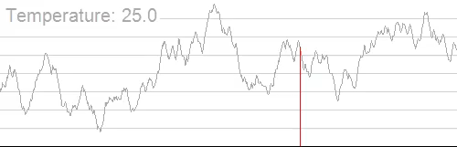
Simulated Annealing
(supposed the h(A) to be maximized)

Slide 31
Simulated Annealing (5)
Can perform multiple backward steps in a row to escape local optima
The chance of finding a global minimum increased
Fast
only one neighbor generated each iteration
whole neighborhood is not checked as in HC
Usually finds a good quality solution in a very short amount of time.

Slide 32
Simulated Annealing (5)
Requires parameters to be set
Starting temperature
must be high enough to escape local optima but not too high to be random exploration of space
Halting temperature
Cooling schedule
typically exponential
Domain knowledge helps set values: size of search space, bounds of maximum and minimum solutions.

Slide 33
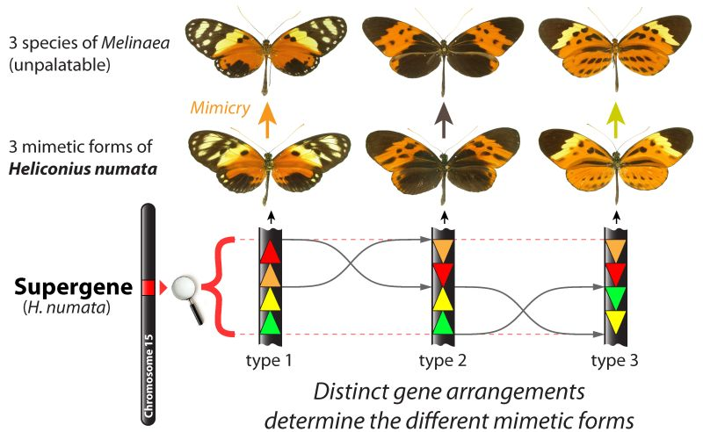
Genetic Algorithms
Nature has always been a great source of inspiration to all mankind.
Genetic Algorithms (GAs)
are search based algorithms based on the concepts of natural selection and genetics.
https://sciencept2dqtr.yolasite.com/resources/pressimage.jpg

Slide 34
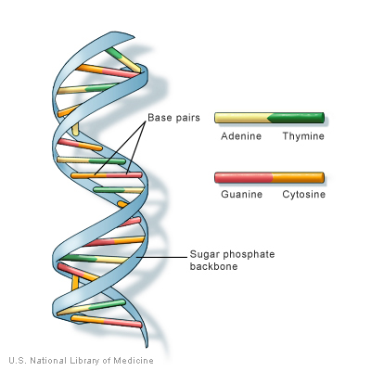
Genetic Algorithms
Optimization algorithms based on evolution as it occurs in nature
Lamarck, Darwin: evolution of species, survival of the fittest
Mendel: genetics provides inheritance mechanism
Essentially a massively parallel search procedure
Start with random population of individuals
Gradually move to better individuals

Slide 35
Genetic Algorithms
Problems are encoded into a representation which allows certain operations to occur
Usually use a bitstring
The representation is key – needs to be thought out carefully
An encoded candidate solution is an individual
Each individual has a fitness which is a numerical value associated with its quality of solution
A population is a set of individuals
Populations change over generations by applying strategies to them

Slide 36
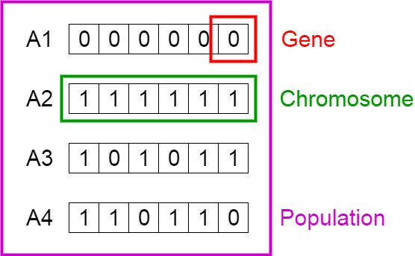
Genetic Algorithms

Slide 37
Typical Genetic Algorithm
Initialize: Population P (size = N) of random individuals (bitstrings)
Evaluate: for each x ∈ P, compute fitness(x)
Loop
For I = 1 to N
Choose 2 parents each with probability proportional to fitness scores (roulette wheel selection)
Crossover the 2 parents to produce a new bitstring (child)
With some small probability mutate child
Add child (and its fitness score) to the population
Until some child is fit enough or you get bored
Return the best individual in the population according to fitness function

Slide 38
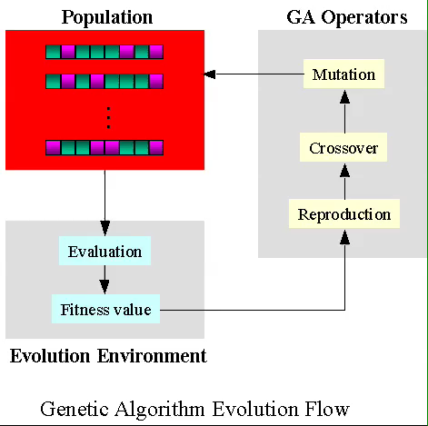
https://www.ewh.ieee.org/soc/es/May2001/14/GAPROC0.GIF

Slide 39
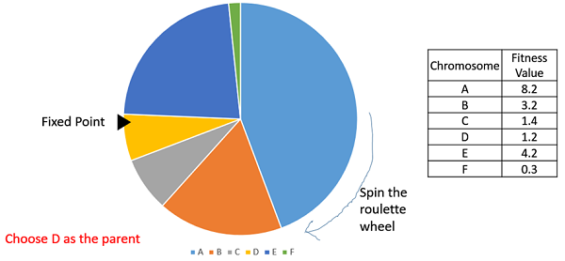
Selection
The idea of selection phase is to select the fittest individuals and let them pass their genes to the next generation.
Evaluate the fitness of each element of the population and build a mating pool. Individuals with high fitness have more chance to be selected for reproduction.
Survival of the fittest

Slide 40
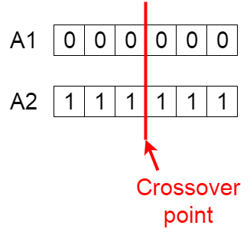
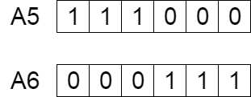
Crossover
Consists of combining parts of individuals to create new individuals
For each pair choose a random crossover point
Cut the individuals there and swap the pieces

Slide 41
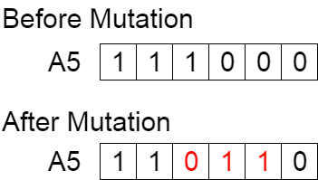
Mutation
Mutation allows use to generate desirable features that are not present in the original population
Typically mutation just means flipping a bit in the string

Slide 42
Termination
The algorithm terminates if the population has converged (does not produce offspring which are significantly different from the previous generation).
Then it is said that the genetic algorithm has provided a set of solutions to our problem.

Slide 43
Example: 8-queens
String representation:
[ 2 4 7 4 8 5 5 2 ]
Fitness:
6+5+ 4+ 4+3+ 1 +1+0 = 24
Fitness function: the number of non-attacking pairs of queens.

Slide 44
Example: 8-queens
String representation:
[ 2 4 7 4 8 5 5 2 ]
Fitness:
6+5+ 4+ 4+3+ 1 +1+0 = 24
Fitness function: the number of non-attacking pairs of queens.

Slide 45
Example
An example of how GA works on the 8-queens problem.

Slide 46
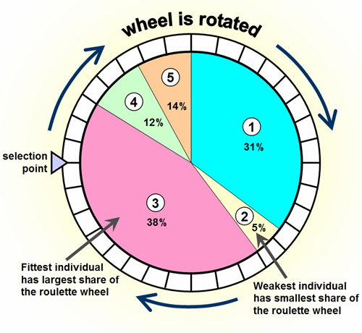
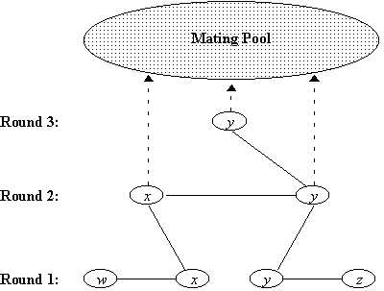
Genetic Algorithm Issues
The algorithm is not sacred, many ways to:
select parents, e.g. roulette, rank (based on fitness), or tournament (x best individuals from random population samples)
do crossover, e.g. 1-point or multiple-point
choose the individuals for next evolution

Slide 47
Genetic Algorithm Issues (2)
The representation of the problem into bitstring is the key
Fitness function then should be designed accordingly
Some parameters need to be tuned:
Size of population (also fixed or not)
Maximum number of generations to be evolved
Crossover locations
Probability of mutation

Slide 48
Genetic Algorithms and Search
Why genetic algorithm is a type of search?
States: possible solutions
Operators: mutation, crossover, selection
Parallel search: since several solutions are maintained in parallel
Hill-climbing on the fitness function
Mutation and crossover allow us to get out of local optima

Slide 49
Your Exercise
Try to perform Genetic Algorithm to find word “bad” from the population of the first 5 alphabet “abcde”.
Fitness score is the number of characters which differ from characters in target string at a particular index. So individual having lower fitness value is given more preference.
For example:
the fitness score for [edc] is 3, because it has 3 characters which differ from the target string [bad]
the fitness score for [bac] is 1, because it has 1 characters which differ from the target string
The algorithm will stop when it founds the offspring with fitness = 0

Slide 50
Your Exercise
You can start with 5 initial population, such as:
['e', 'd', 'c'], fitness = 3
['e', 'e', 'a'], fitness = 3
[’b', 'e', 'a'], fitness = 2
['c', 'c', 'c'], fitness = 3
['c', 'e', 'c'], fitness = 3

Slide 51
Summary
Complete Searching
Look through solution space for better solution
nodes : complete solution
edges : operator changes to another solution
can stop at any time
technique suited for:
hard problems, e.g., TSP
optimization problems.

Slide 52
Summary (2)
Localized Searching
f(n): evaluates quality of solution by using domain knowledge
HC: maximizes f(n), VF: minimizes f(n)
solution found determined by starting point
can get stuck, prevents finding global optima
SA: explores then settles down
bad moves accepted with probability that decreases as the search progress (T decreases) and with the badness of move (δE worsens)
requires parameters to be set

Slide 53
References
Russell, S..J. ,& Norvig, P. (2010). Artificial intelligence: A Modern Approach (3rd Ed.). New York: Pearson. ISBN: 860-1419506989

